Slide 1


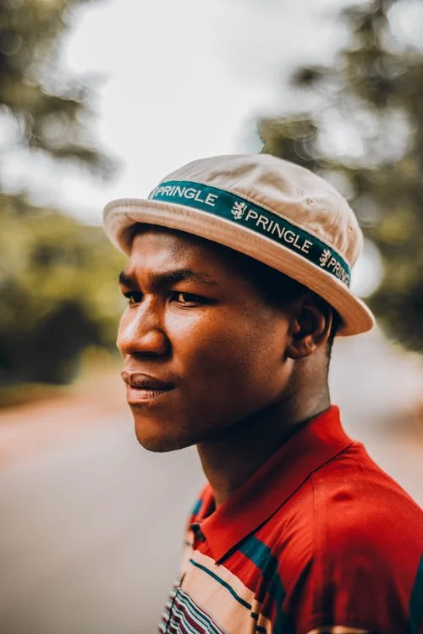


I’m in FYE WHAT DOES THAT MEAN AND WHAT HAPPENS NOW?
Simone Williams
FYE Coordinator

Slide 2
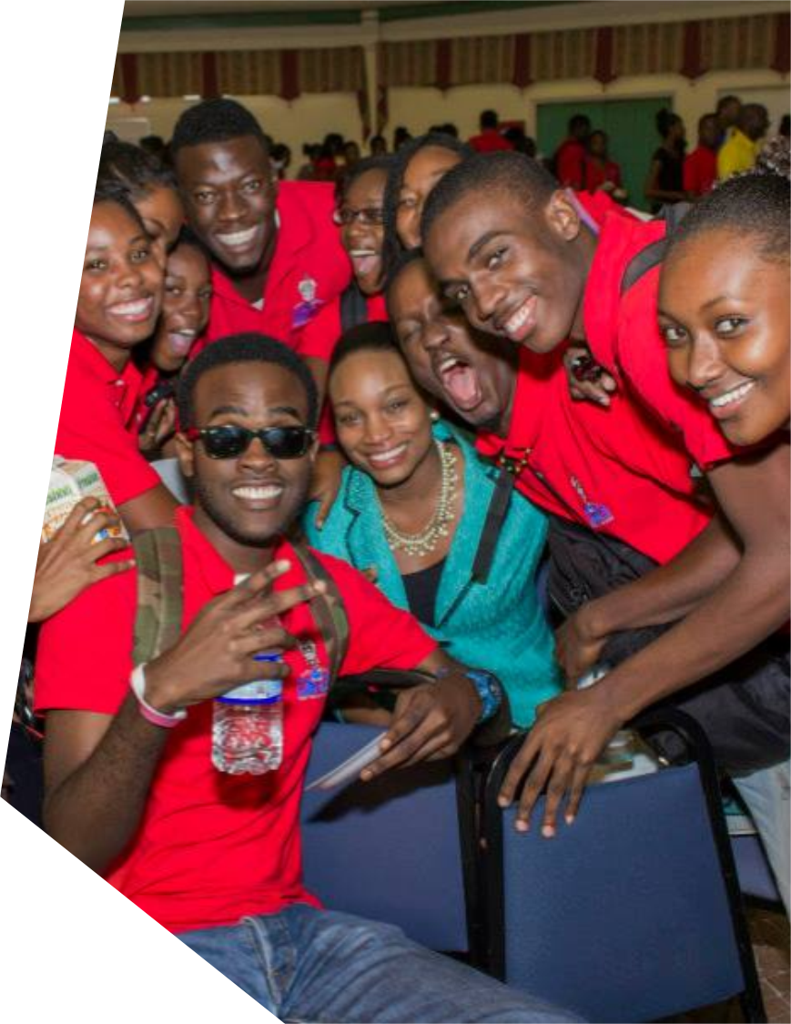
FYE stands for The First Year Experience FYE is UWI’s gift to first year students. It is a support programme for first year students. In small groups of 15 students, one peer mentor and a UWI staff you spend a year having fun, making friendships and navigating UWI together.

Slide 3

1. Join WhatsApp Group You have been either added to a WhatsApp Group or Sent a WhatsApp link. Please join

Slide 4

2. Introduce Yourself
Once in the group, say hi and introduce yourself. Your introduction can be very simple or really detailed. You get to decide!

Slide 5

3. Start Connecting Your peer mentor and facilitator will create community. Participate. You will make friends by activities, games, etc.

Slide 6

4. Commit to Once Weekly Sessions Your group meets weekly on Zoom or Google Meet. Attend these meetings. Participate, engage, share and have fun!

Slide 7

5. Have heart to heart. Disclose FYE helps best when you share the things which are difficult for you. Your facilitator will assist in finding solutions

Slide 8

6. Be open to Receiving Joy FYE requires you to be open to fun, family, and friendships. Be also open to being happy and to doing well in school. FYE is positivity
z

Slide 9

6. Be Willing to Become Better FYE unearths talents. FYE also challenges you to change the habits which do not support your success. Be willing.

Slide 10

7. Say YES! Decide to stick with FYE, because growth and change take time and friendships are built overtime
z

Slide 11

8. Stay for the fun Intercampus meet ups FYE groups link up Socials and lymes
z

